Slide 1
Education and Income Outcomes Prediction of Income from Education and Work Class
Rosalie Day – Final Report, Capstone 1 - January 2020
Springboard, Data Science Career Track Curriculum

Slide 2
Conventional wisdom – a living wage require a college degree Bachelor’s degree – the symbolic threshold, adapting to future of work
Purpose-
Inform public policy: projecting employment and workforce development needs
Information: education level and employment sector status used for predicting outcomes
Generalizable approaches

Slide 3
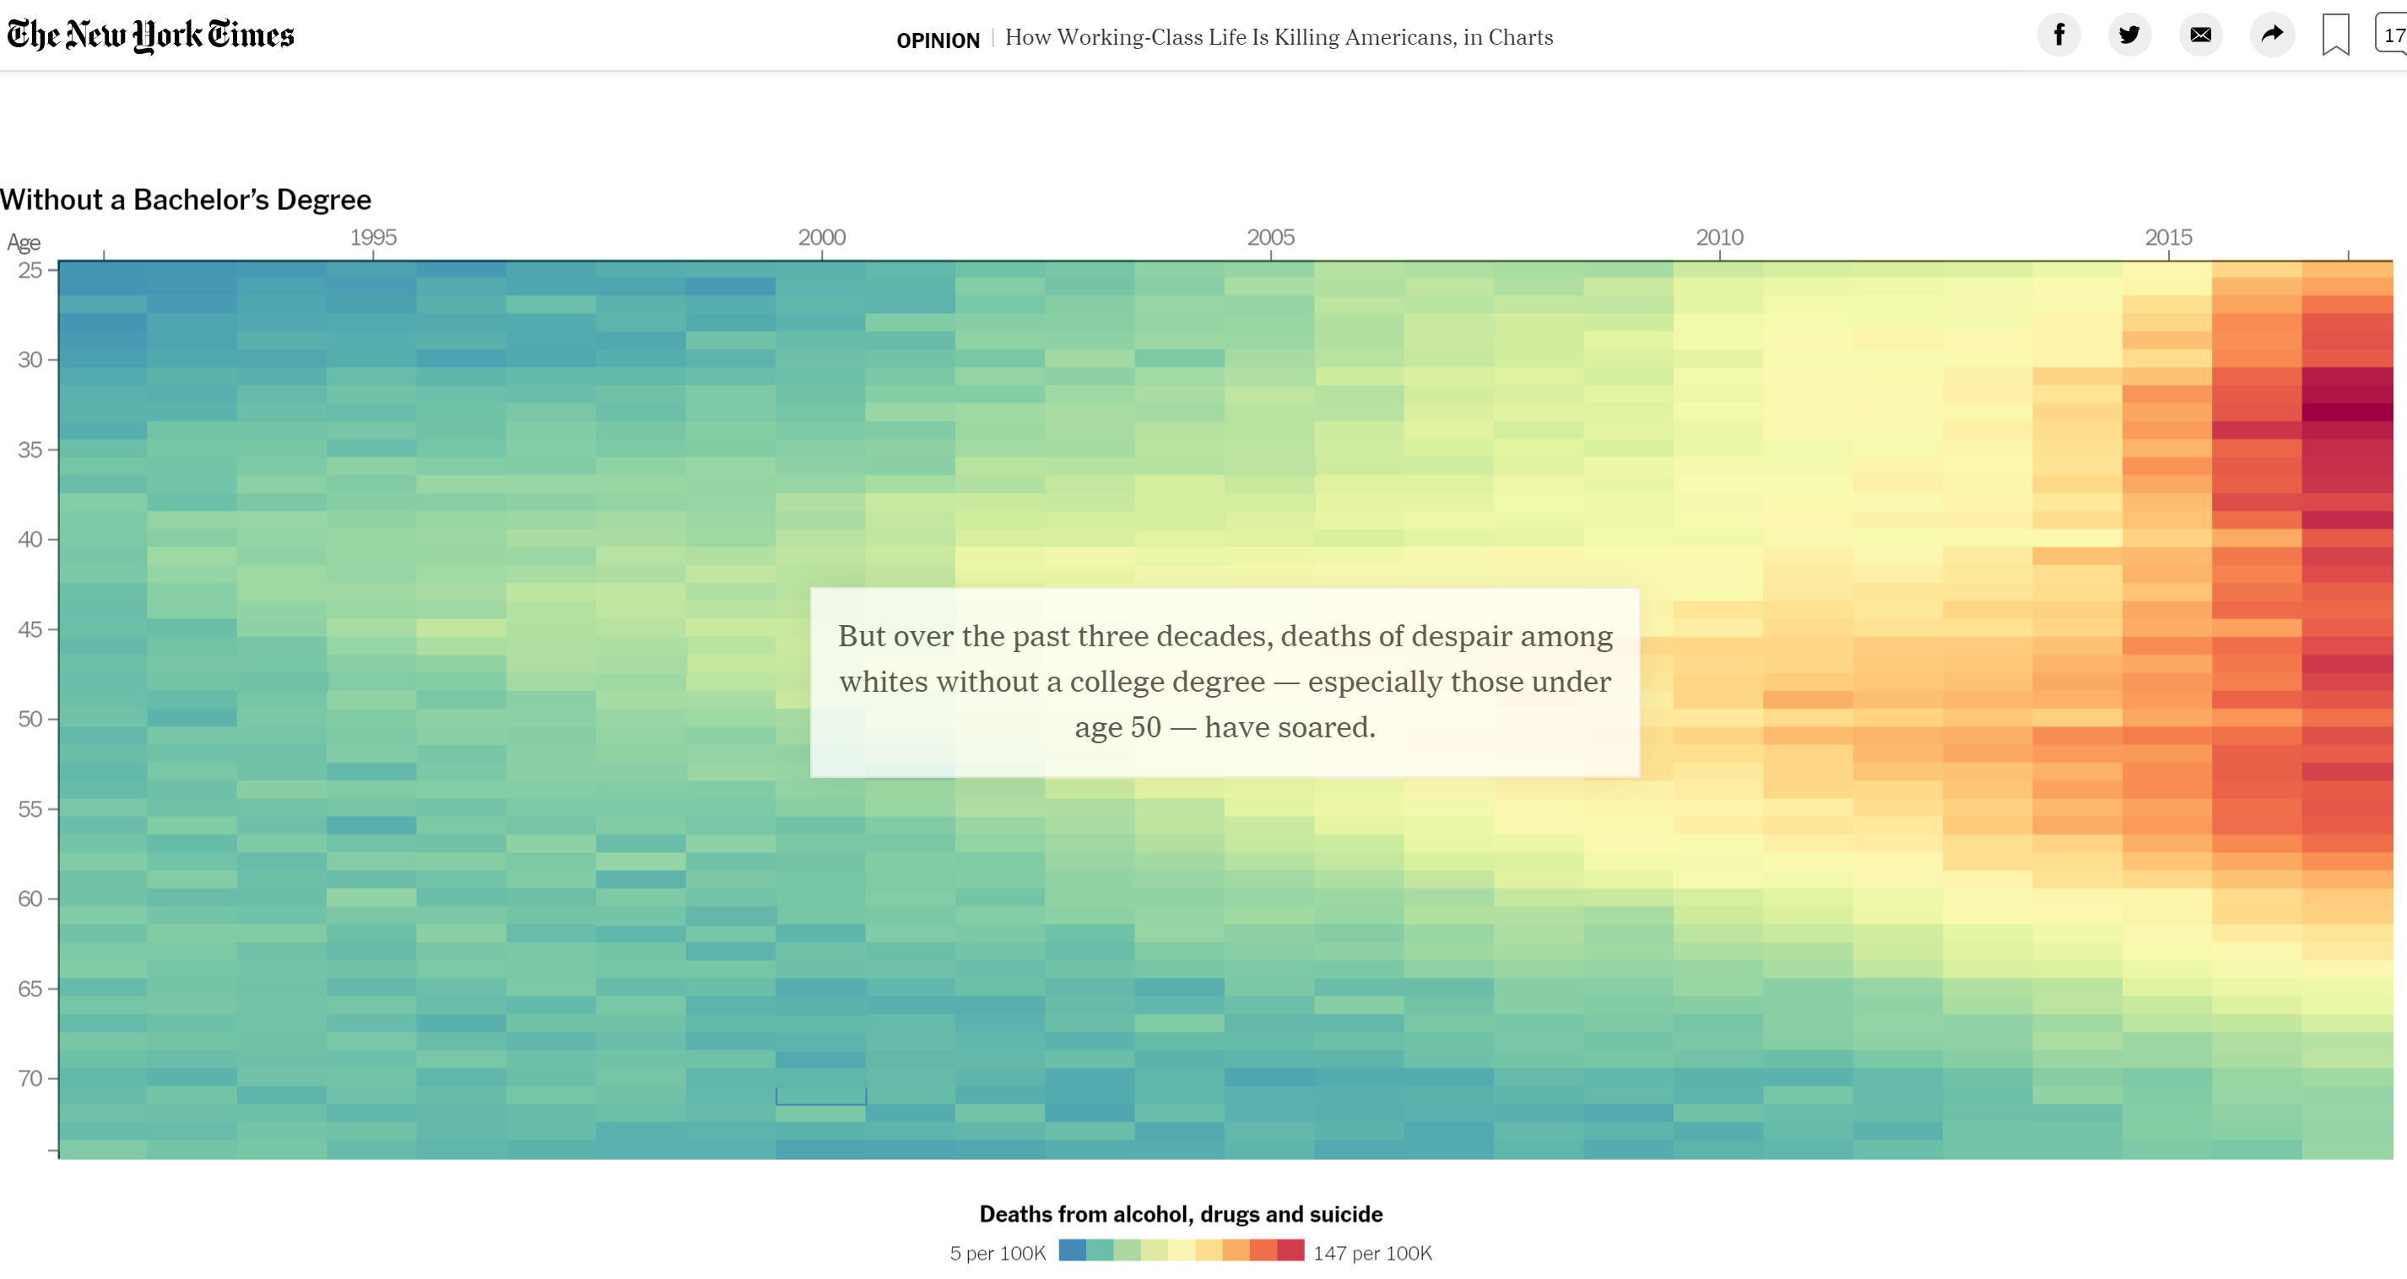
Conventional wisdom? Graphic NYT March 6, 2020 – Article by David Leonhardt & Stuart A Thompson

Slide 4
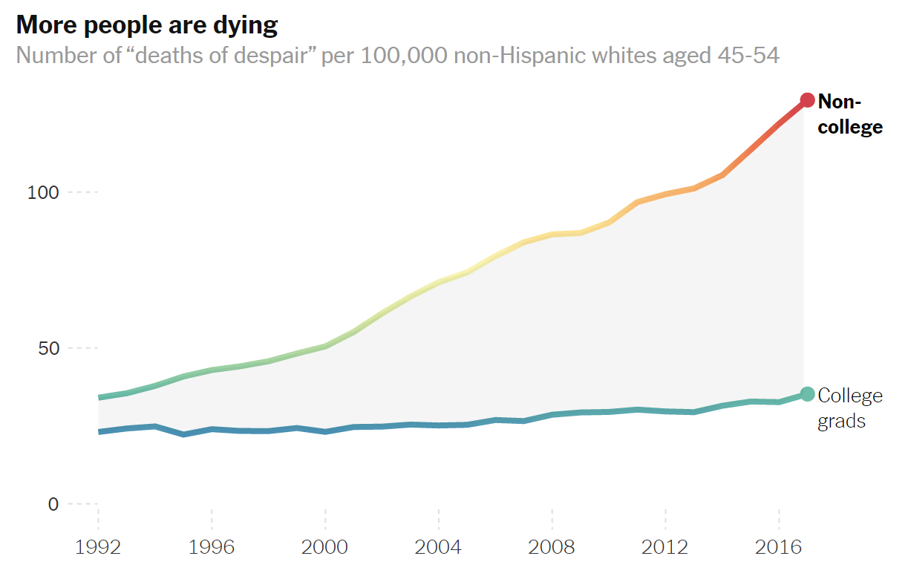
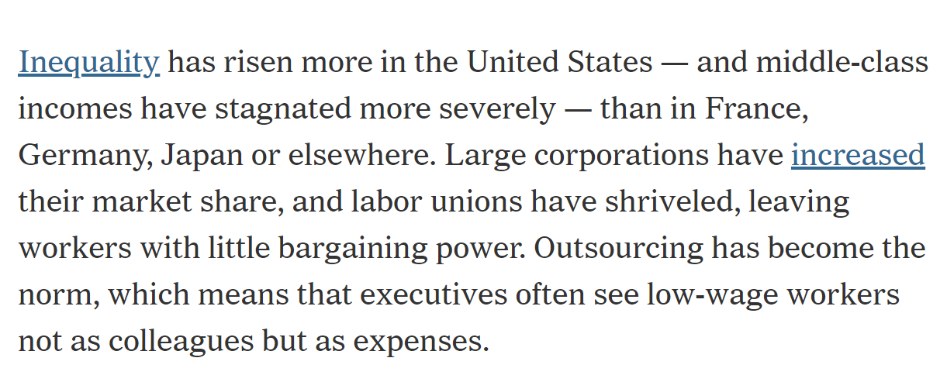
More than conventional wisdom – policy issue in 1994, and now NYT Opinion, March 6, 2020 - Article by David Leonhardt & Stuart A Thompson

Slide 5
The DATA – 1994 US Census Adult Census Income on Kaggle website Income: < or = $50,000; > $50,000 “Good job” for 1994 data
Sample size: 48842
Nine predictors for classification of income outcomes
demographic variables: age, race, gender, country of origin, family
attributes of interest: education levels and work class

Slide 6
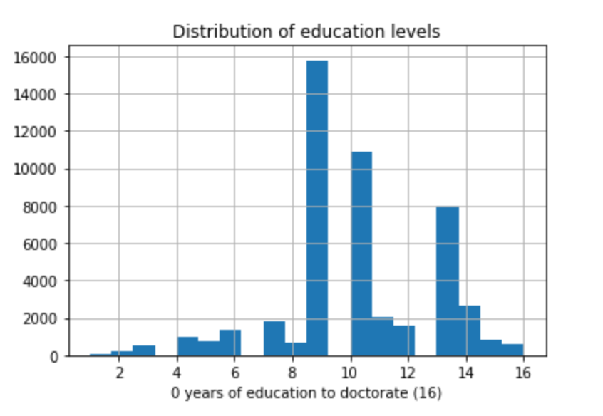
Education levels
16 - Doctorate
15 – Professional school
14 – Master’s
13 - Bachelor’s
12 - Associate’s, academic
11 - Associate’s, vocational
10 - Some college (median)
9 - High school
1 - 8 Not a HS graduate

Slide 7
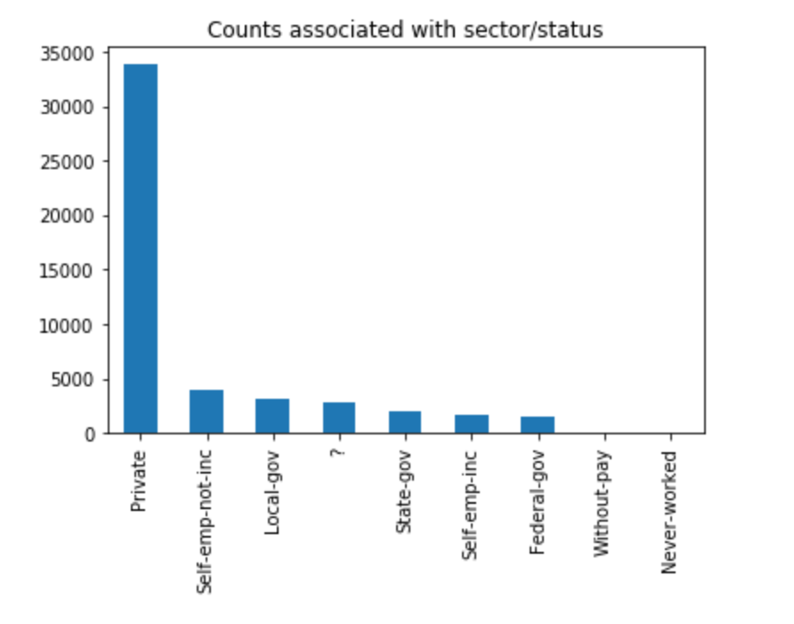
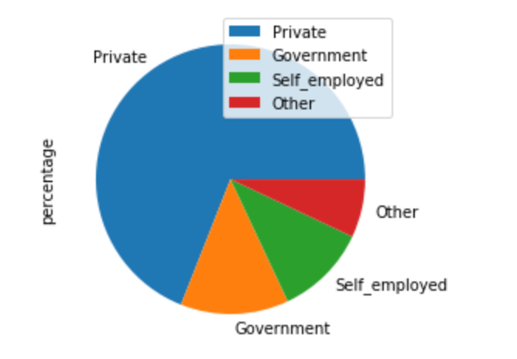
Work class attribute
“work class” levels
conventional sector categories
(aggregated levels)

Slide 8
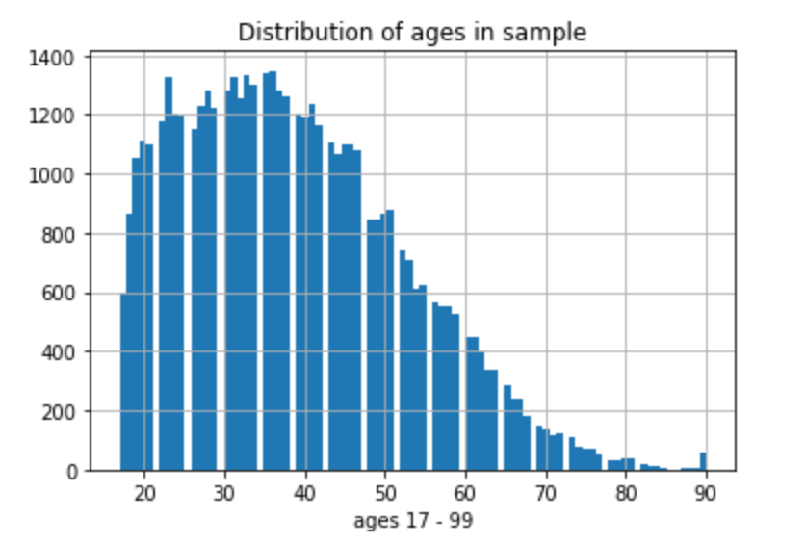
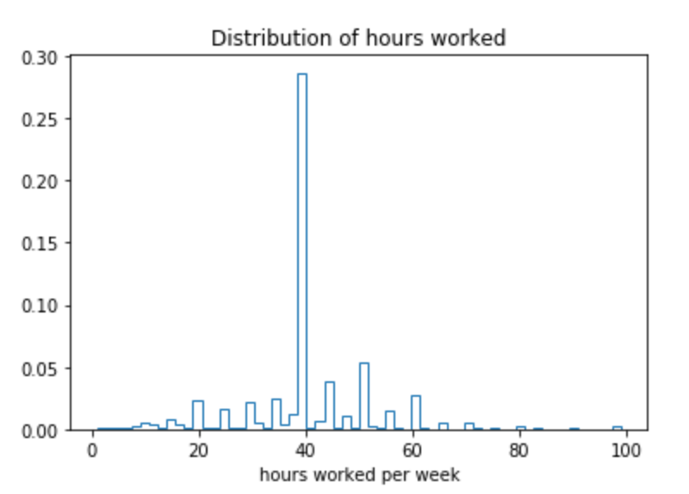
Non-categorical predictor attributes
Age: average 38.6; median 37
Hours per week: average 40.4;
standard deviation 12.4

Slide 9
Inferential statistics revealed three results Project focuses on exploring education as predictor
A four-year college degree significantly impacted the income outcome as compared with no bachelor’s degree.
Work class, which is a combination of work-sector and -status, and the level of education are significantly correlated.
Hours-per-week worked was independent from education.

Slide 10
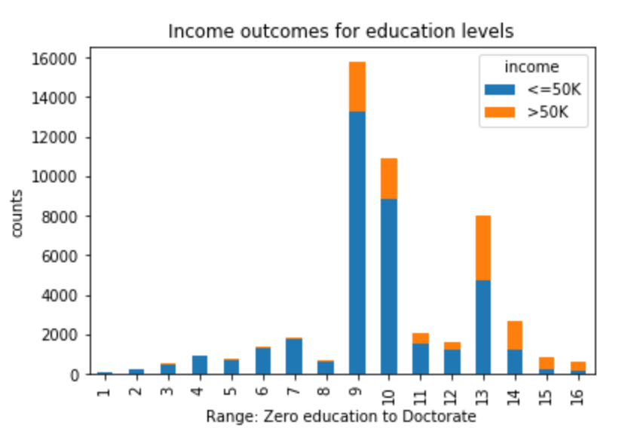
Income for education levels
9 = high school
graduate
10 = some
college
(median)
13 = bachelor’s
degree

Slide 11
Hypothesis Testing 1. Relationship of Education to Income Outcome
Null hypothesis: No differential effect on income outcome between
BA = bachelor’s degree & no additional degrees (8025)
No BA = without bachelor’s degree (36372)
Two-sample t-test from scipy stats
Significant t-statistic, -52.4087 and a p-value of 0.0
Reject null -
Alternate: Outcomes, greater than $50k income, are more likely with
bachelor’s degrees than any education level short of a bachelor’s degree

Slide 12
Hypothesis Testing 2. Association of Education level and Work class
Null hypothesis is that education and workclass are independent attributes.
Cross-tabulation of education and workclass was created from crosstab function in pandas
Testing association - chi-squared statistic is 3906.1080 with 120 degrees of freedom and p-value of 0.0.
Reject null -
Alternate: Work class and education are significantly correlated

Slide 13
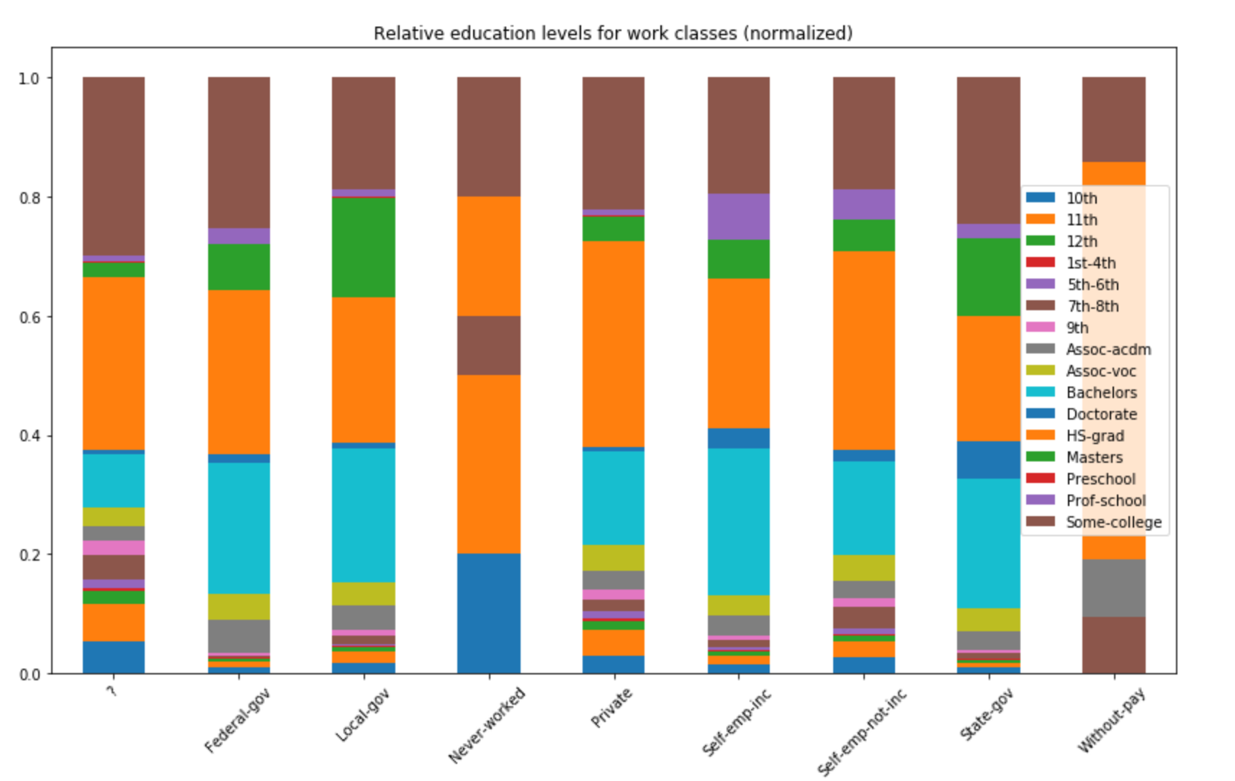
Comparison of education levels for work class categories - High school graduates comprised the largest level in almost all work classes. - ‘Some college” level was second and the median, followed by bachelor’s degrees.

Slide 14
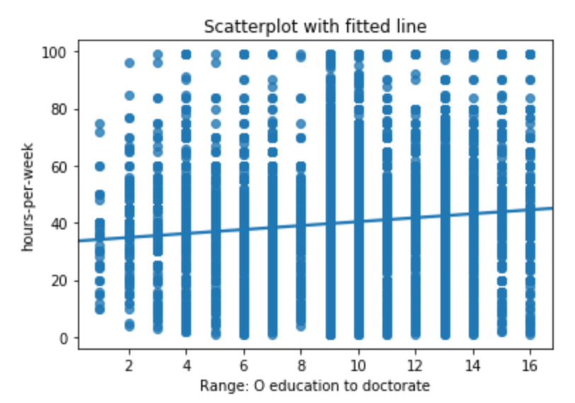
Hypothesis Testing 3. Education correlated with hours per week
Fitted line plotted in Seaborn
Null hypothesis: Education and ‘hours-per-week’ are independent variables.
If hours worked were correlated positively with education level, that relationship could affect the income outcome.
Test correlation pairs - researchpy library
small r value of 0.1437
Not rejected. No significant correlation.

Slide 15
CLASSIFICATION - Predict the Income target variable
Predictors -classification of income outcomes
Demographic: age, race, gender, country of origin, family
Attributes of interest: education levels and employment sector and status
Processed with Pandas get_dummies
Trained on 70% of data
Supervised machine learning models from Scikit-Learn:
K-Nearest Neighbors (KNN);
Logistic Regression;
Decision Trees,
Random Forest; and
Gradient Boosting

Slide 16
Prediction with test data -Performance evaluations: confusion matrix, classification report. -Income outcomes classifications on complete set of attributes.
Best performing models
Equal: Gradient Boosting and Logistic Regression
Both accuracy scores (f1) = .84
Both AUC (area under curve) round to .89
All the rest –
- Decision Tree accuracy f1 = 0.79
- Random Forest accuracy f1 = 0.81
- KNN accuracy f1 = 0.82
(largest true negative)

Slide 17
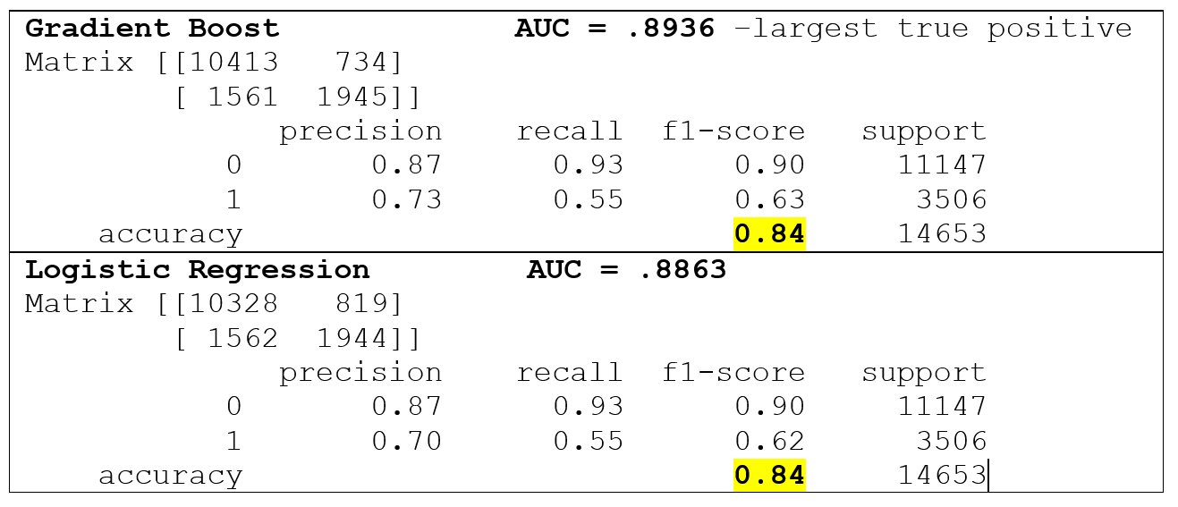
Evaluating the best performing models

Slide 18
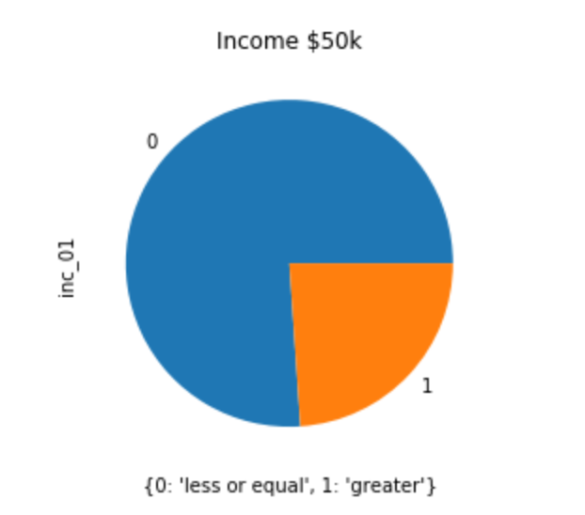
Perspective on predicting
For perspective, the “null accuracy” is .76, which is the probability of selecting a person with less than $50,000 income from this sample.
All the prediction models perform better than random on the full set of attributes and the ones selected for education prediction and privacy.

Slide 19
Prediction with limited attributes . . . preferred models performed almost equally well
Predictors of interest: education, work class
Two others: age, hours per week
With five fewer predictors, accuracy scores = .80 and .79
lost .04 for Gradient Boosting, result .80
lost .05 for Logistic Regression result .79.
Differential could reflect the small edge in AUC score of Gradient Boosting model.

Slide 20
More Research
The parameters for Logistic Regression and Gradient Boosting could be tuned for better performance.
Classification modeling on data at 10- to 12-year increments to explore whether the education levels and sector profiles changed for the income threshold similar to this one could provide more information for workforce development policy, with limited attributes and data privacy considerations.

